Slide 1

Hi-Tech Institute of Engineering & Technology
Hi-Tech Institute of Engineering and Technology
Project : Parking Information System
Under the Guideness of
Ass.Prof Sakshi Mehra
Department Of Electronics & Communication
Team member
Manish Kumar(1422031017)
Rajat tyagi(1422031023)
Rocky Bhushan(1422031024)
Upendra kumar(1422031028)

Slide 2
Contents
Introduction
What is parking information system ?
Why are we doing this project ?
Components we are using in this project
Our Website
Block diagram
Applications
Future scope

Slide 3
Introduction
lot. This project deals with the Parking Information of vehicle in parking
This project is very helpful to both owner of parking lot as well as to the public.
Parking information is displayed on server as which parking is empty or occupied. And it is easily accessible by public.
Empty slot is indicated by the respective Green slot. And occupied slot is indicated by Red slot.

Slide 4
what is parking information system?
In this project we are trying to implement the information of parking lot as the parking is available or not, display in website or android app.
So, it is easy for public to see the parking information at the website, if parking is available then online payment for the parking lot after that enters into parking lot and park vehicle.
It is a dynamic approach to see the parking information. This leads to save fuel, time and money.

Slide 5
Why are we doing this project ?
Now days in many multiplex systems there is a severe problem for car parking system.
Moreover there is a lot of men labor involved for this process for which there is lot of investment.
So the need is to develop a system which indicates directly which parking slot is vacant or occupied in any lane.
That’s why we are making this project.

Slide 6
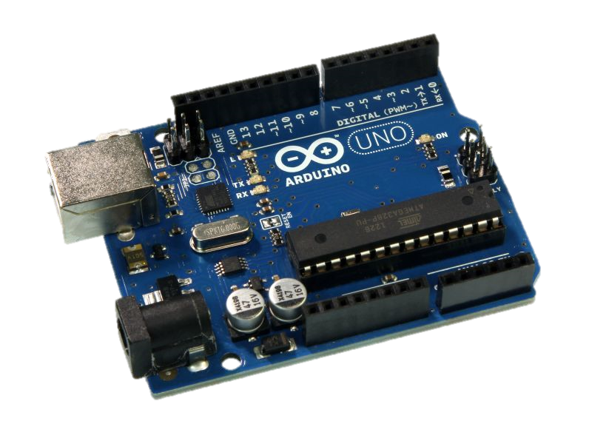
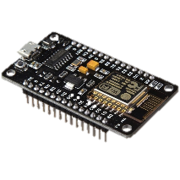
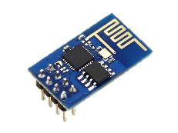
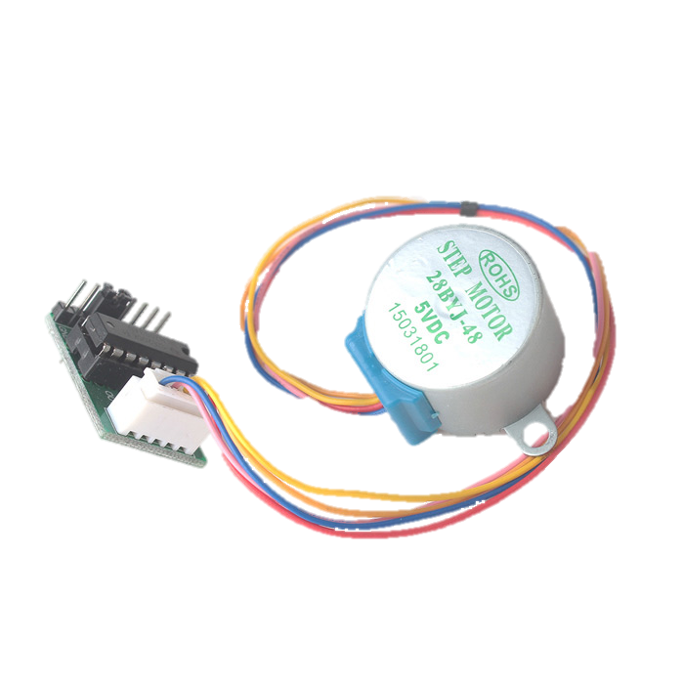
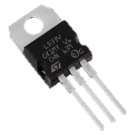
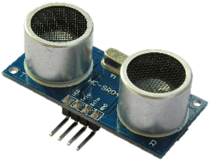
Components we are using in this Project
Arduino UNO
Node MCU
ESP 8266
LD33V Voltage Regulator
Ultrasonic Sensor HC-SR04
Stepper Motor

Slide 7
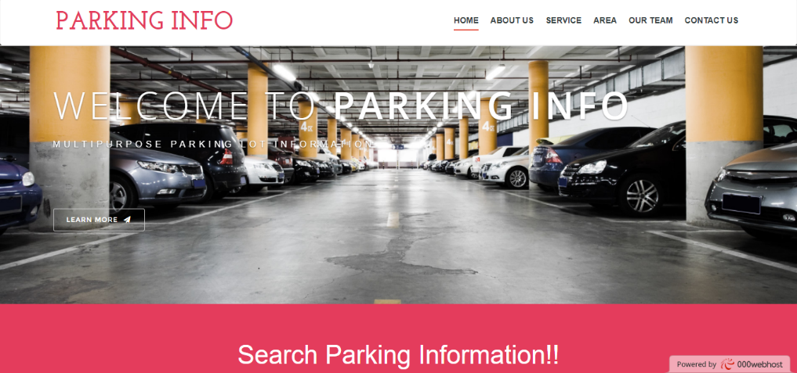
Our Website
We made a Website in which we will show the parking area.
Website is Parkinginfo.000webhostapp.com

Slide 8
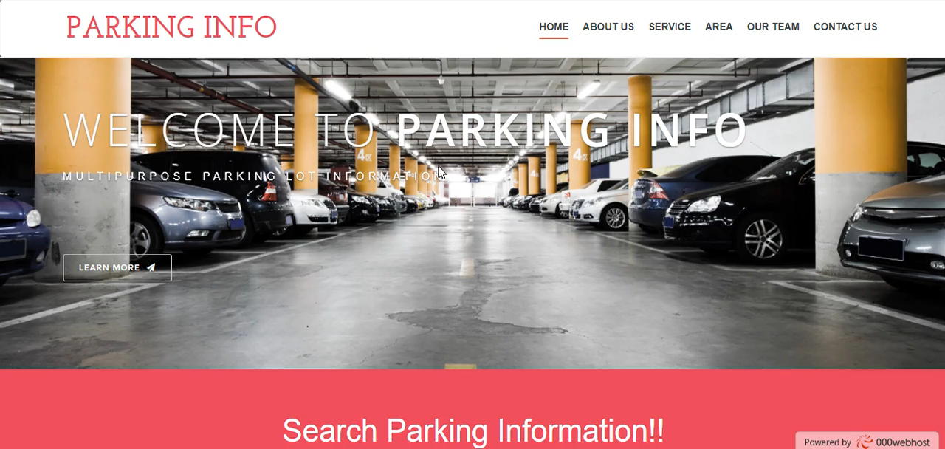

Slide 9
Block Diagram
Ultrasonic
sensor
Wi-Fi
Module
Website/App
Parking
area
Security
System
Payment
system

Slide 10
Applications
Important factor in traffic areas.
Automated without human being.
Sensors are used for sensing the vehicles.
Can be used for industries, commercial offices and educational institutes.

Slide 11
Future Scope
This can be expanded in the sense of security. Using CCTV cameras security of the parking area can be enhanced.
We can add pick and place facility to park the cars automatically.

Slide 12

Thank you

Slide 13


